Slide 1

MEAN Stack Workshop
BY ANAND KUMAR

Slide 2
ANAND KUMAR

Slide 3
What is our plan?
JavaScript
Node JS
Express JS
Mongo DB
Angular

Slide 4
Outline : Node JS
Getting started with Node.js
Node Package Manager
Modules
Asynchronous Programming
Callbacks
Events and Event Loop
Streams and Buffers
Connecting Node.js to Database
Web Sockets

Slide 5
Getting started with Node.js
Why Node JS
What is Node JS
What is unique about Node JS
Blocking vs Non-Blocking
Success Stories
When to use it.
Node JS for

Slide 6
Why Node JS?
“Node's goal is to provide an easy way to build scalable programs”
Non Blocking I/O
V8 Javascript Engine
Single Thread with Event Loop
40,025 modules
Windows, Linux, Mac
1 Language for Frontend and Backend
Active community

Slide 7
What is Node JS?
Asynchronous i/o framework
Core in c++ on top of v8
Rest of it in javascript
Can handle thousands of Concurrent connections with Minimal overhead (cpu/memory) on a single process
It’s NOT a web framework, and it’s also NOT a language

Slide 8
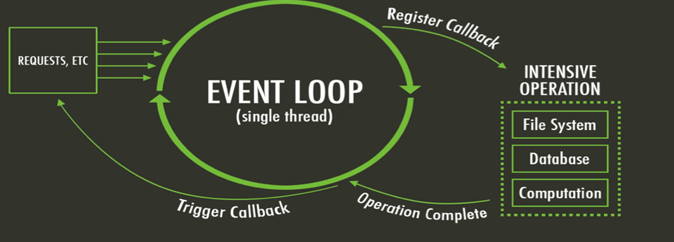
What is unique about Node JS
JavaScript on server-side thus making communication between client and server will happen in same language
Servers normally thread based but Node.JS is “Event” based. Node.JS serves each request in a Evented loop that can handle simultaneous requests.

Slide 9
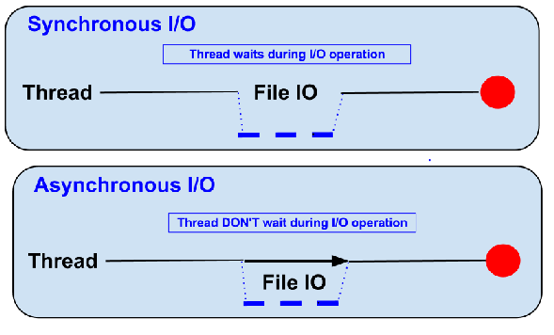
Blocking vs Non-Blocking
Example :: Read data from file and show data

Slide 10
Blocking…
Read data from file
Show data
Do other tasks
var data = fs.readFileSync( “test.txt” );
console.log( data );
console.log( “Do other tasks” );

Slide 11
Non – Blocking..
Read data from file
When read data completed, show data
Do other tasks
fs.readFile( “test.txt”, function( err, data ) {
console.log(data);
});

Slide 12
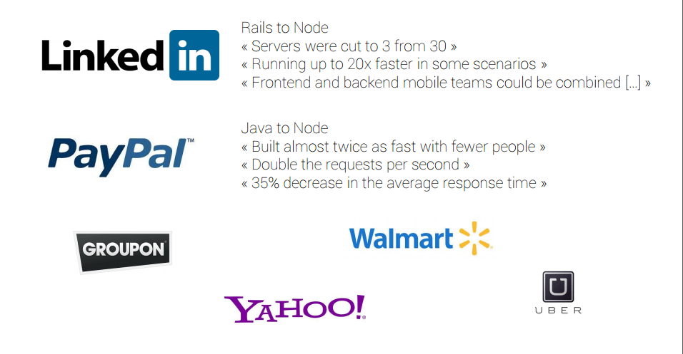
Success Storeis…

Slide 13
When to use it?
Chat/Messaging
Real-time Applications
Intelligent Proxies
High Concurrency Applications
Communication Hubs
Coordinators

Slide 14
Node JS for
Web application
Websocket server
Ad server
Proxy server
Streaming server
Fast file upload client
Any Real-time data apps
Anything with high I/O

Slide 15
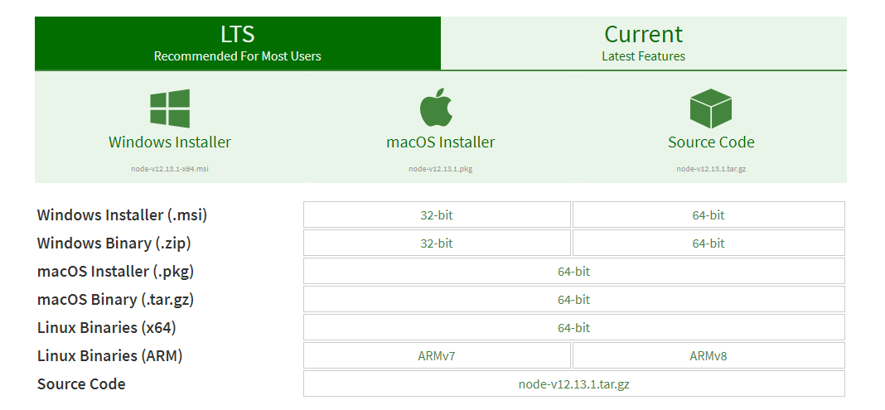
Installation and usages
Download Node JS from https://nodejs.org/en/download/
Install the binary with default options
Verify node installed?
node -v

Slide 16
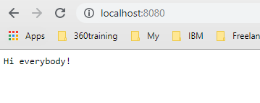
My First Program
const http = require('http');
const server = http.createServer(function(req, res) {
res.end('Hi everybody!');
});
server.listen(8080);

Slide 17
My First Program (Extended..)
const http = require('http');
var instructionsNewVisitor = function (req, res) {
res.end('Hi everybody!');
}
var server = http.createServer(instructionsNewVisitor);
server.listen(8080);

Slide 18
Another Example.. Load HTML
var http = require('http');
var server = http.createServer(function(req, res) {
res.writeHead(200, {"Content-Type": "text/html"});
res.end('<p>Here is a paragraph of <strong>HTML</strong>!</p>');
});
server.listen(8080);

Slide 19
Another Example.. Load multiple HTML pages on different URL’s
var http = require('http');
var url = require('url');
var server = http.createServer(function (req, res) {
var page = url.parse(req.url).pathname;
res.writeHead(200, { "Content-Type": "text/plain" });
if (page == '/') {
res.write('You\'re at the reception desk. How can I help you?');
}
else if (page == '/basement') {
res.write('You\'re in the wine cellar. These bottles are mine!');
}
else if (page == '/floor/1/bedroom') {
res.write('Hey, this is a private area!');
}
res.end();
});
server.listen(8080);

Slide 20
Query Parameter Example..
var http = require('http');
var url = require('url');
var querystring = require('querystring');
var server = http.createServer(function (req, res) {
var params = querystring.parse(url.parse(req.url).query);
res.writeHead(200, { "Content-Type": "text/plain" });
if ('firstname' in params && 'lastname' in params) {
res.write('Your name is ' + params['firstname'] + ' ' + params['lastname']);
}
else {
res.write('You do have a first name and a last name, don\'t you?');
}
res.end();
});
server.listen(8080);

Slide 21
Assignment…
Convert Login and Dashboard page program into new Node JS programs.

Slide 22
Solution?

Slide 23
Node Package Manager
Node Package Manager (NPM) is a command line tool that installs, updates or uninstalls Node.js packages in your application
It is also an online repository for open-source Node.js packages.
The node community around the world creates useful modules and publishes them as packages in this repository.
Website : https://www.npmjs.com/

Slide 24
package.json
{
"name": “ExampleApp",
"version": "0.0.0",
"description": " ExampleApp with Express dependency",
"main": "app.js",
"author": {
"name": "Dev",
"email": ""
},
"dependencies": {
"express": "^4.13.3"
}
}

Slide 25
Node JS Modules
In the Node.js module system, each file is treated as a separate module.
App.js ➔
const circle = require('./circle.js');
console.log(`The area of a circle of radius 4 is ${circle.area(4)}`);
myMath.js ➔
const { PI } = Math;
exports.area = (r) => PI * r ** 2;
exports.circumference = (r) => 2 * PI * r;

Slide 26
Node.js Module Types
Node.js includes three types of modules:
Core Modules
Local Modules
Third Party Modules

Slide 27
Core Modules
The core modules are compiled into its binary distribution and load automatically when Node.js process starts.
To use them in your application, you need to import first in your application.

Slide 28
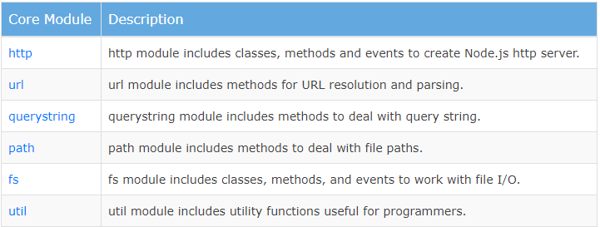
Core Modules

Slide 29
Local Modules
Local modules are modules created locally in your Node.js application.
Normally, different functionalities of your application in separate files and folders.
Note : You can also package it and distribute it via NPM, so that Node.js community can use it.

Slide 30
Third Party Modules
Third party modules are modules which are exposed publically on NPM.
Normally, we require them in our project and perform what we wish to do.
i.e, mongo db management.
const mongoose = require('mongoose');

Slide 31
Visit…..
https://www.npmjs.com/

Slide 32
Practice… Read data from file
const fs = require(“fs”)
fs.readFile(‘./data.txt’,’utf8’,(err,data) => {
if(err){
return console.error(err);
}
}

Slide 33
Assignment…
Load HTML from file to page.
Hints : Use HTTP and FS modules in code.

Slide 34
Practice… Write data from file
const fs = require(“fs”)
fs.writeFile(‘./data.txt’,’This is a message from Node JS’,’utf8’,(err,data) => {
if(err){
return console.error(err);
}
}

Slide 35
Assignment…
Write a program which convert CSV file content into JSON data.
Write a program which accept cityname in command line argument and return with message after find the city name on https://www.foodpanda.com.
Output: “Foodpanda is delivery in <cityname>”.

Slide 36
Event & Event Emitter
$('#toBeClicked').on('click', function() { alert('clicked') })
Here we handle a click event on the element with id ‘toBeClicked’. When the element is clicked, a ‘click’ event is emitted which is handled.

Slide 37
Event & Event Emitter
EventEmitters are basically an Object that creates/dispatches multiple signals types on demand and usually use Strings to define the message name.
Node.js uses EventEmitter internally a lot but creates some callback-like APIs to abstract/simplify the process, like the http.createServer method:
http.createServer(sample_function).listen(8080);

Slide 38
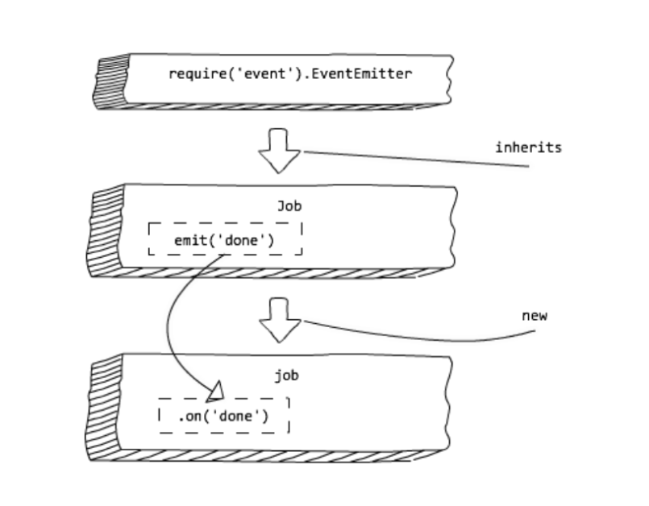
Event & Event Emitter

Slide 39
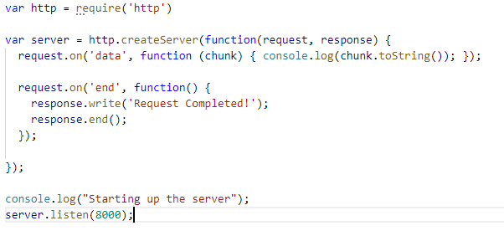
Example..

Slide 40
Streams & Buffers
Types of Streams
Readable streams
To create a stream of data for reading (reading a large file in chunks).
Writable streams
To create a stream of data for writing (writing a large amount of data to a file).
Duplex streams
To create a stream that is both readable and writable at the same time. We can read and write to a duplex stream (a socket connection between a client and a server).
Transform streams
To create a stream that is readable and writable, but the data can be modified while reading and writing to the stream (compressing data by the client and server before while requesting).

Slide 41
Streams & Buffers
Streams work on a concept called buffer.
A buffer is a temporary memory that a stream takes to hold some data until it is consumed.
If we try to push some data into the stream, the data is pushed into the stream buffer. The pushed data sits in the buffer until the data is consumed.
If the buffer is full and we try to push data to a stream, the stream does not accept that data and returns with a false value for the push action.

Slide 42
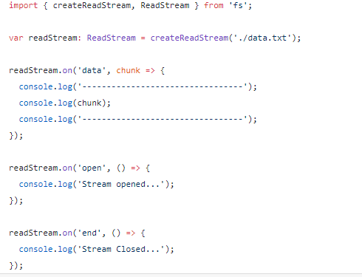

Slide 43
Outline : Express JS
Introduction to Express JS
Routing
HTTP Interaction
Handling Form Data
Handling Query Parameters
Cookies and Sessions
User Authentication
Error Handling
Creating and Consuming RESTful Services
Using Templates

Slide 44
Introduction to Express JS
Express is a small web framework that sits on top of Node.js’s web server functionality to simplify its APIs and add helpful new features.
It makes it easier to organize your application’s functionality with middle ware and routing.
It adds helpful utilities to Node.js’s HTTP objects.
It facilitates the rendering of dynamic HTTP objects.

Slide 45
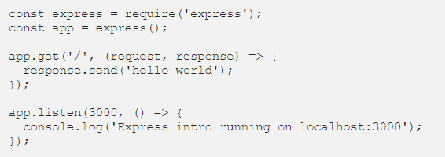
Introduction to Express….. Setup
npm install express

Slide 46
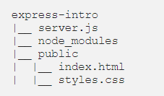

Introduction to Express….. How to Serve Static Assets
An actual HTML file with styling.

Slide 47
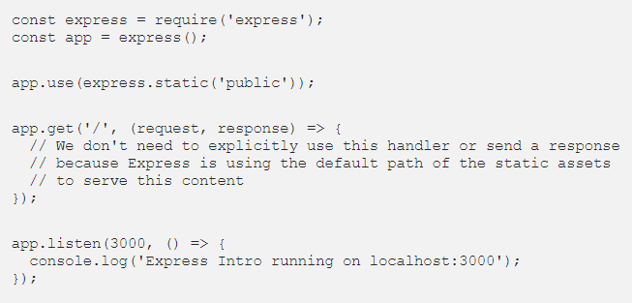
Example…

Slide 48

Introduction to Express….. How to Serve JSON

Slide 49
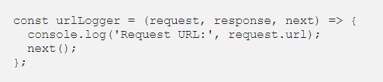


Introduction to Express….. Middleware

Slide 50
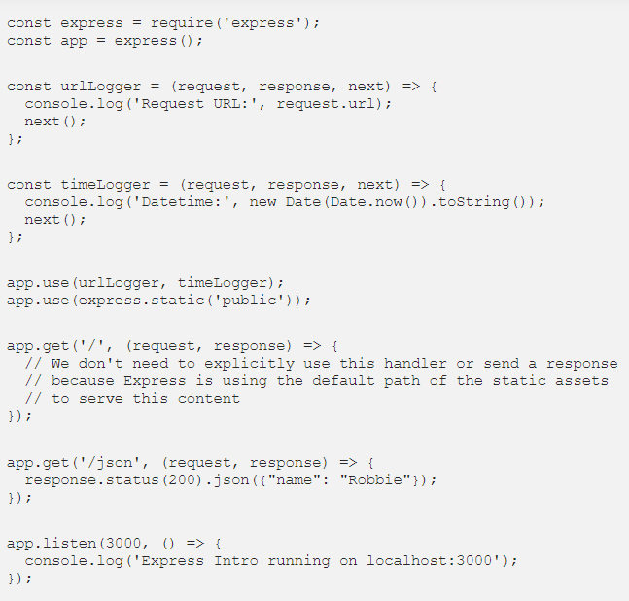

Slide 51

Routing
Routing refers to determining how an application responds to a client request to a particular endpoint.
i.e, a URI (or path) and a specific HTTP request method (GET, POST, and so on)

Slide 52
Routing… Example

Slide 53
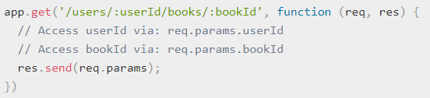
Routing… Example
http://localhost:3000/users/34/books/8989

Slide 54
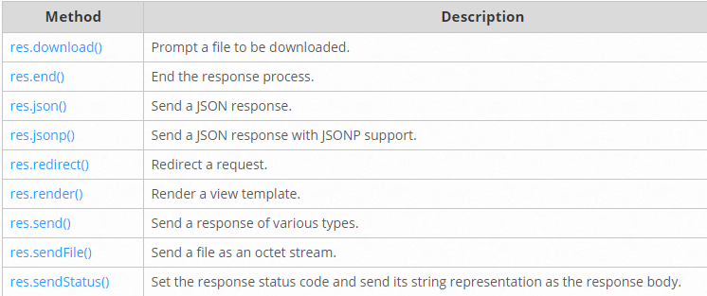
Routing… Response Methods

Slide 55
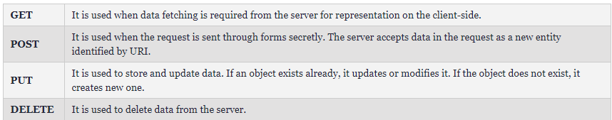
HTTP Interaction…. Methods

Slide 56
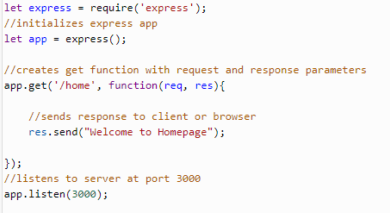
Practice….
GET
POST
PUT
DELETE

Slide 57
Handling Form Data??

Slide 58
Cookies and Sessions
https://www.npmjs.com/package/cookie-session

Slide 59
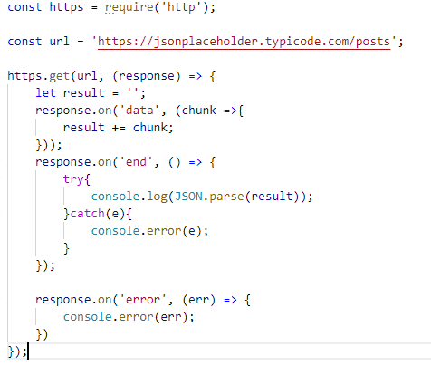
Consuming external service

Slide 60
Assignments..
Create a POST service, which respone the json data after converting from csv file.
Create a GET service, which return all foodpanda delivery cities names.
Create a Application which post a registration form to API, which stores the values in a file. Send Success or Fail in response only.

Slide 61
Outline : Mongo DB
Introduction
Who are using Mongo
RDBMS vs NoSql
Usages
CRUD
CRUD Examples
Features
Sharding
Other Featrues

Slide 62
Mongo DB
MongoDB is an open-source database that uses a document-oriented data model and a non-structured query language.
It is one of the most powerful NoSQL systems and databases around, today.
It is an architecture that is built on collections and documents.
This database uses a document storage format called BSON which is a binary style of JSON documents

Slide 63












Who using Mongo

Slide 64
RDBMS vs NoSQL
RDBMS |  | MongoDB
Database |  | Database
Table, View |  | Collection
Row |  | Document (JSON, BSON)
Column |  | Field
Index |  | Index
Join |  | Embedded Document
Foreign Key |  | Reference
Partition |  | Shard

Slide 65
Usage…
> db.user.findOne({age:39})
{
"_id" : ObjectId("5114e0bd42…"),
"first" : "John",
"last" : "Doe",
"age" : 39,
"interests" : [
"Reading",
"Mountain Biking ]
"favorites": {
"color": "Blue",
"sport": "Soccer"}
}

Slide 66
CRUD
Create
db.collection.insert( <document> )
db.collection.save( <document> )
db.collection.update( <query>, <update>, { upsert: true } )
Read
db.collection.find( <query>, <projection> )
db.collection.findOne( <query>, <projection> )
Update
db.collection.update( <query>, <update>, <options> )
Delete
db.collection.remove( <query>, <justOne> )

Slide 67
CRUD example
> db.user.insert({
first: "John",
last : "Doe",
age: 39
})
> db.user.find ()
{
"_id" : ObjectId("51…"),
"first" : "John",
"last" : "Doe",
"age" : 39
}
> db.user.update(
{"_id" : ObjectId("51…")},
{
$set: {
age: 40,
salary: 7000}
}
)
> db.user.remove({
“ObjectId": 51..
})

Slide 68
Features
Document-Oriented storege
Full Index Support
Replication & High Availability
Auto-Sharding
Querying
Fast In-Place Updates
Map/Reduce

Slide 69
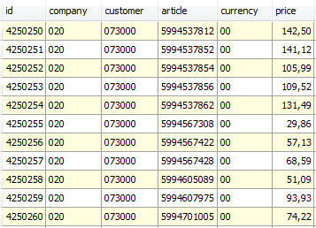
Sharding
Partition your data
Scale write throughput
Increase capacity
Auto-balancing
shard₁
shard₂
Host1:10000
Host2:10010
configdb
Host3:20000
Client
Host4:30000

Slide 70
Other features
Easy to install and use
Detailed documentation
Various APIs
JavaScript, Python, Ruby, Perl, Java, Java, Scala, C#, C++, Haskell, Erlang
Community
Open source

Slide 71
Mongo DB Installation
Download
https://www.mongodb.com/download-center/community
Installation

Slide 72
Mongo DB Tool Experience

Slide 73
Practice..
Mongo+ExpressJS

Slide 74
Outline : Angular
Introduction
Fundamentals
HTTP
Router
Module
Handling Errors

Slide 75
Introduction
What is Angular?
The Angular is the latest version of the AngularJS, which is a development platform for building mobile and desktop web applications. The Angular now comes with every feature you need to build a complex and sophisticated web or mobile application.

Slide 76
Introduction
History
https://github.com/angular/angular/blob/master/CHANGELOG.md

Slide 77
Introduction
It is built using JavaScript.
It is a UI framework for building mobile and desktop web applications.
It is an open-source and helps us build dynamic & single-page applications (SPAs).

Slide 78
Features
Two-Way Data Binding
Data binding is automatic and fast. changes made in the View is automatically updated in the component class and vice versa
Powerful Routing Support
The powerful routing engine loads the page asynchronously on the same page enabling us to create a Single Page Applications.

Slide 79
Features
Expressive HTML
Angular enables us to use programming constructs like if conditions, for loops, etc to render and control how the HTML pages.
Modular by Design
Angular follows the modular design. You can create Angular modules to better organize and manage our codebase

Slide 80
Features
Built-in Back End Support
Angular has built-in support to communicate with the back-end servers and execute any business logic or retrieve data
Active Community
Angular is Supported by google and has a very good active community of supporters. This makes a lot of difference as your queries are quickly resolved.

Slide 81
Architecture
The Architecture of an Angular Application is based on the idea of Components.
An Angular application starts with a Top-level component called Root Component.
Then other child components forming a tree of loosely coupled components.

Slide 82
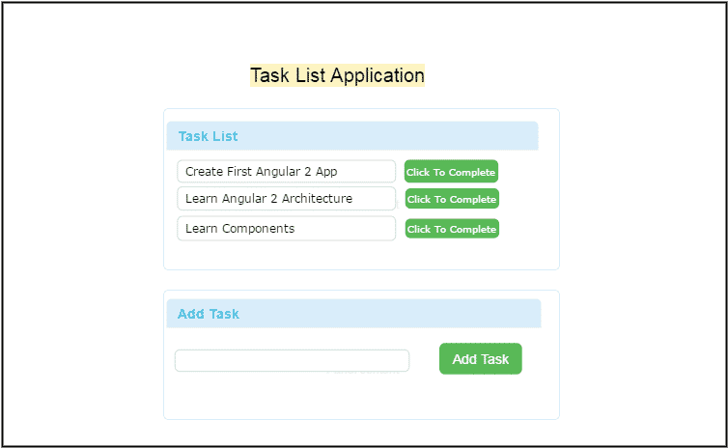
Architecture
Consider the simple application.

Slide 83
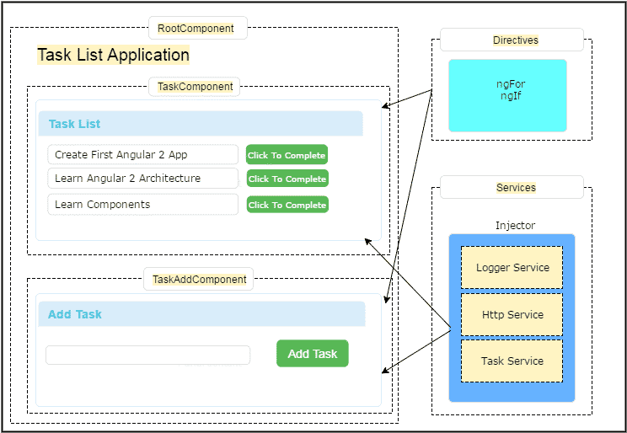
Architecture

Slide 84
Getting Started
Required Tools
Visual Studio Code
Package Manager
Module Loader
Angular CLI
It is a tool developed by the Angular team to enable developers to quickly create Angular projects without wasting time.

Slide 85
First Project/Workspace
Install the Angular CLI
npm install -g @angular/cli
Validate Angular CLI Version
ng --version
Create a workspace and initial application
ng new GettingStarted
Run the application
cd my-app
ng serve

Slide 86
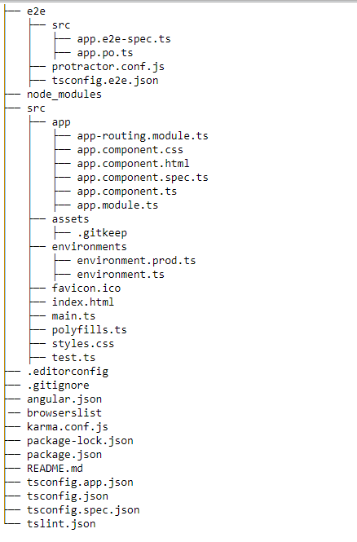
Angular Project Folder Structure

Slide 87
Fundamentals
Components
Directives
Pipes
Modules

Slide 88
Component
The component contains the data & user interaction logic that defines how the View looks and behaves.
Components are plain JavaScript classes and defined using @component Decorator.

Slide 89
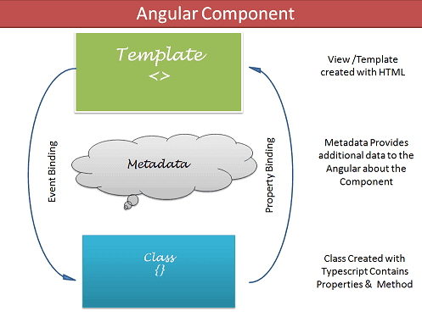
Component
The Components consists of three main building blocks.
Template
Class
MetaData

Slide 90
Components… Template (View)
The template defines the Layout of the View and defines what is rendered on the page.
Templates are created with HTML.
There are two ways you can specify the Template in Angular.
Defining the Template Inline
Provide an external Template

Slide 91
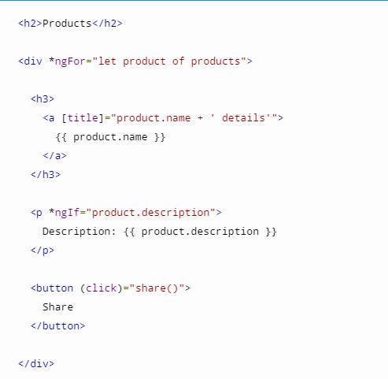
Components… Template (View)

Slide 92
Components… Class
The class is the code associated with Template (View).
Class Contains the Properties & Methods.
The Properties of a class can be bind to the view using Data Binding.

Slide 93
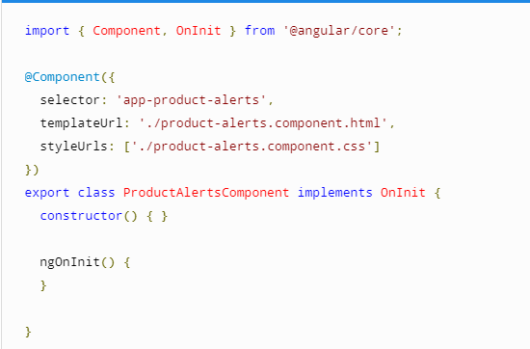
Components… Class

Slide 94
Components… MetaData
Metadata Provides additional information about the component to the Angular.
The Metadata is defined with a decorator.
@component is a decorate, which defines the class as Component to the Angular.
A class only becomes a Component when Component Decorator is used.

Slide 95
Directives
The Directive helps us to manipulate the DOM.
You can change the appearance, behavior or a layout of a DOM element using the Directives.
The Angular directives are classified into three categories based on how they behave.
Component
Structural
Attribute Directives

Slide 96
Directives… Structural Directive
Structural directives can change the DOM layout by adding and removing DOM elements.
Commonly used directives.
ngFor
ngSwitch
ngIf

Slide 97
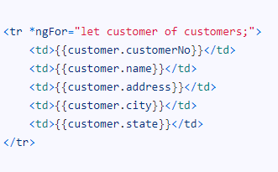
Structural Directive.. ngFor
The ngFor used to repeats a portion of HTML template once per each item from an itterable list (Collection).

Slide 98
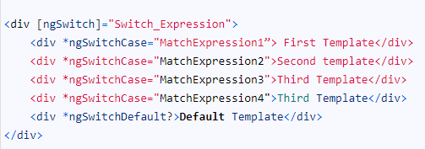
Structural Directive.. ngSwitch
The ngSwitch directive lets you add/remove HTML elements depending on a match expression. ngSwitch directive used along with NgSwitchCase and NgSwitchDefault.

Slide 99
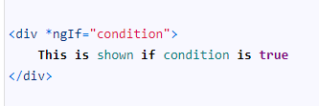
Structural Directive.. ngIf
The ngIf Directives is used to add or remove HTML Elements based on an expression.

Slide 100
Directives… Attribute Directive
An Attribute or style directive can change the appearance or behaviour of an element. Commonly used directives.
ngModel
ngClass
ngStyle

Slide 101

Attribute Directive…. ngModel
The ngModel directive is used the achieve the two-way data binding.
Two-way binding is used mainly in data entry forms. Whenever user makes changes in the data, we would like to update our model in the component with the new data and if the model changes, we would like to update the view as well

Slide 102

Attribute Directive…. ngClass
The ngClass is used to add or remove the CSS classes from an HTML element.
Using the ngClass one can create dynamic styles in HTML pages

Slide 103

Attribute Directive…. ngStyle
ngStyle is used to change the multiple style properties of our HTML elements.

Slide 104

Pipes
There are many circumstances where we may have to change the appearance of the data before presenting it the user.
Expression : is the expression, which you want to transform
| : is the Pipe Character
pipeOperator : name of the Pipe
pipeArguments: arguments to the Pipe

Slide 105
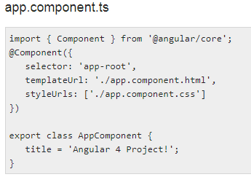

Pipes… Example

Slide 106
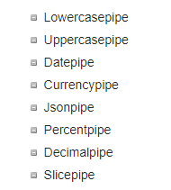
Pipes…Built-in

Slide 107
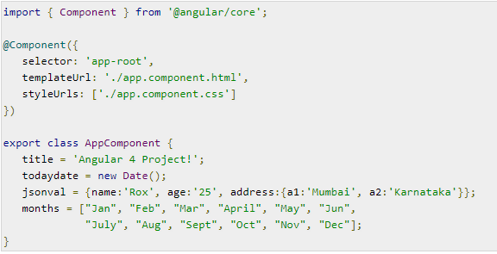

Slide 108
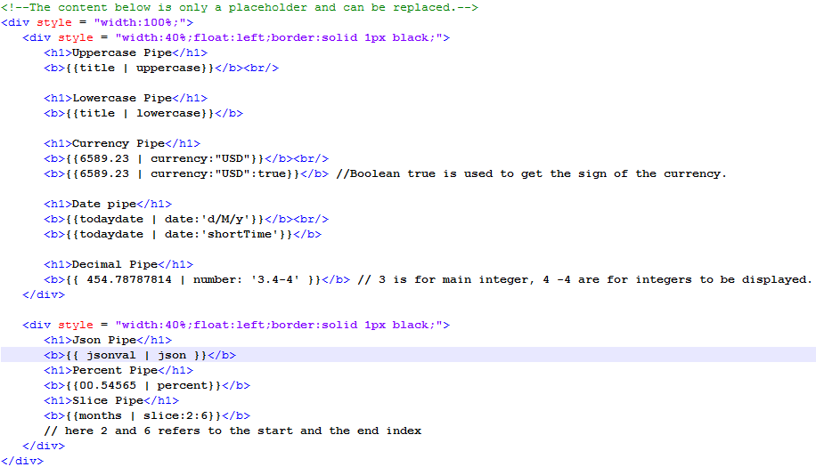
Pipes… Exmple

Slide 109
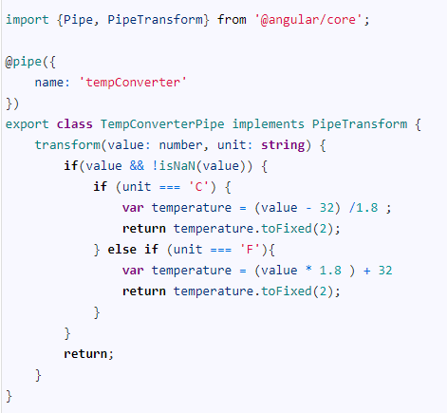
Pipes… Custom

Slide 110
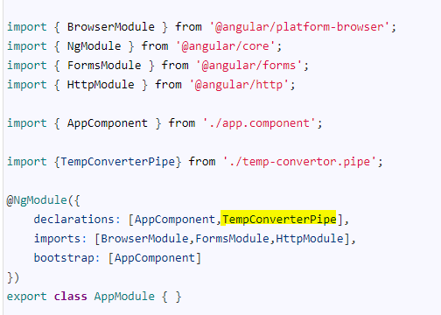
Pipes… Custom

Slide 111
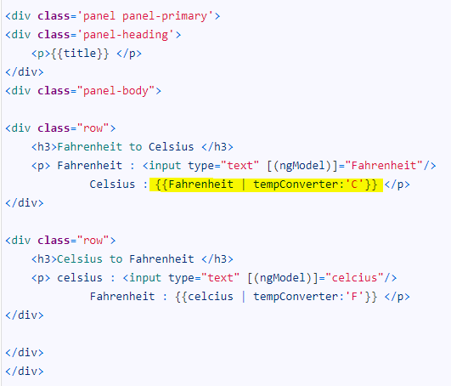
Pipes… Custom

Slide 112
HTTP
The HttpClient is a separate model in Angular and is available under the @angular/common/http package.
HttpClient.Get method will be used to send an HTTP Request and Subscribe to the response Asynchronously.

Slide 113
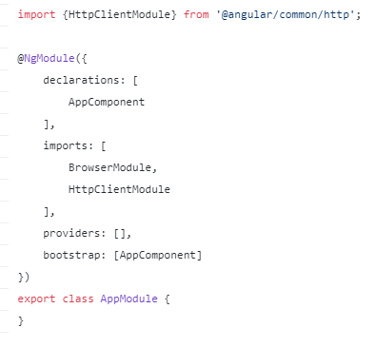
Installing the new HTTP module
In order to install the HTTP module, we need to import it in our root module HttpClientModule

Slide 114
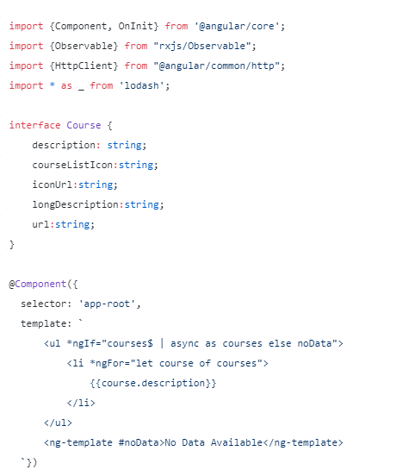
Example of an HTTP GET

Slide 115
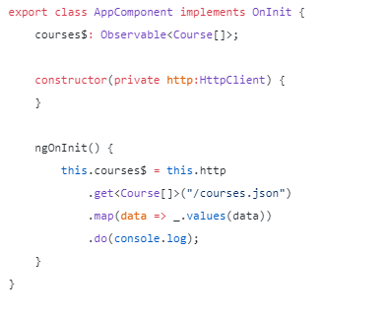
Example of an HTTP GET

Slide 116
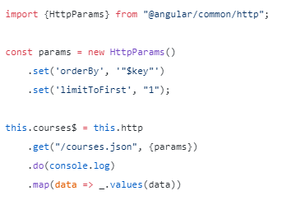
HTTP Request Parameters

Slide 117
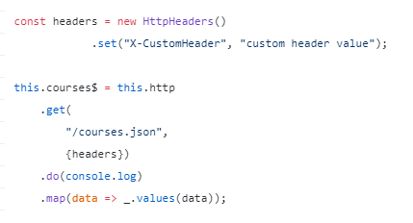
HTTP Headers

Slide 118
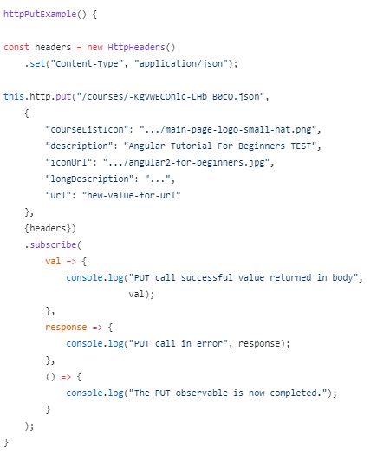
HTTP PUT

Slide 119
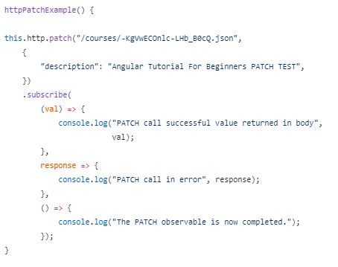
HTTP PATCH

Slide 120
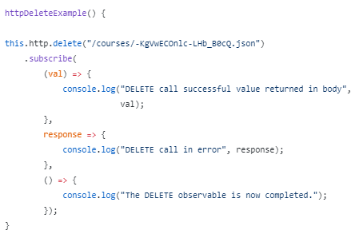
HTTP DELETE

Slide 121
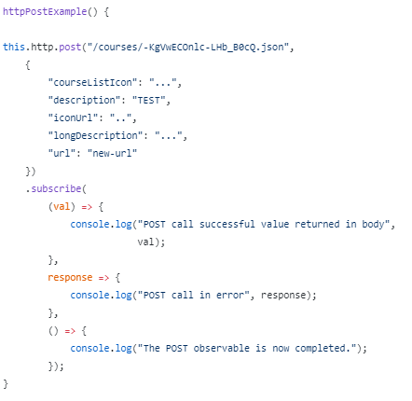
HTTP POST

Slide 122
Router
The Router module handles the navigation & Routing in Angular
It provides a complete routing library with the possibility to have multiple router outlets, different path matching strategies, easy access to route parameters and route guards to protect components from unauthorized access.
The Angular router is a core part of the Angular platform. It enables developers to build Single Page Applications with multiple views and allow navigation between these views.

Slide 123

THE ROUTER-OUTLET
The Router-Outlet is a directive that’s available from the router library where the Router inserts the component that gets matched based on the current browser’s URL.

Slide 124
ROUTES AND PATHS
Routes are definitions (objects) comprised from at least a path and a component (or a redirectTo path) attributes.
The path refers to the part of the URL that determines a unique view that should be displayed, and component refers to the Angular component that needs to be associated with a path.

Slide 125
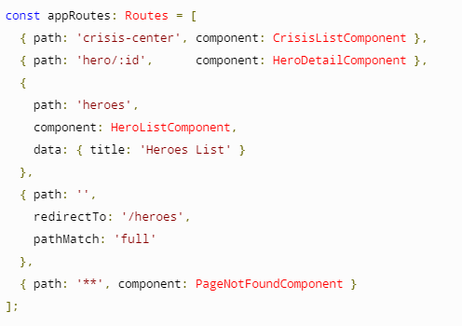
ROUTES AND PATHS

Slide 126
ROUTE MATCHING STRATEGIES
There are two matching strategy available in Angular Route
Prefix
Full

Slide 127
ROUTE PARAMS
We can create a route parameter using the colon syntax.

Slide 128
ROUTE GUARDS
The Angular router’s navigation guards allow to grant or remove access to certain parts of the navigation.
Here are the 4 types of routing guards available:
CanActivate: Controls if a route can be activated.
CanActivateChild: Controls if children of a route can be activated.
CanLoad: Controls if a route can even be loaded. This becomes useful for feature modules that are lazy loaded. They won’t even load if the guard returns false.
CanDeactivate: Controls if the user can leave a route. Note that this guard doesn’t prevent the user from closing the browser tab or navigating to a different address. It only prevents actions from within the application itself.

Slide 129
ROUTE GUARDS… Example
Let’s see an example with a CanActivate route guard where we ask an auth service if the user is authenticated

Slide 130
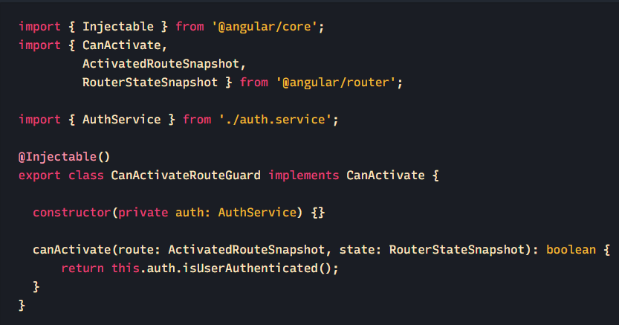
can-activate-route.guard.ts

Slide 131
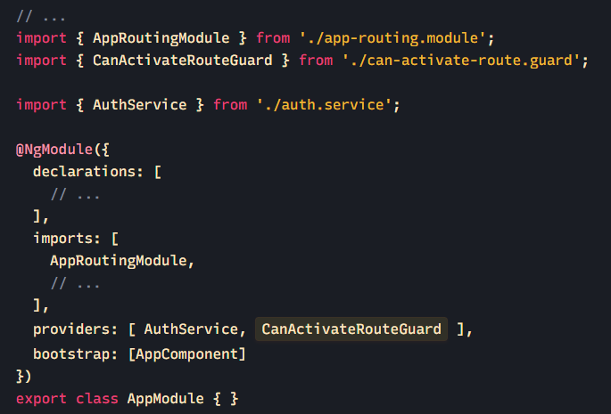
ROUTE GUARDS… Example
In order to use them, route guards should be provided just like services
app.module.ts

Slide 132
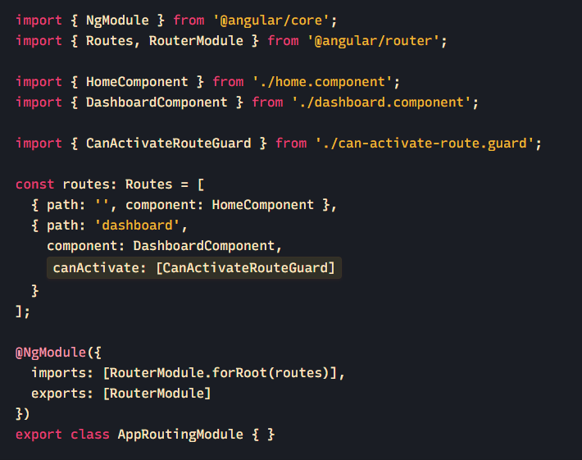
app-routing.module.ts

Slide 133
Practice.
Install the Angular CLI
npm install -g @angular/cli
Validate Angular CLI Version
ng --version
Create a workspace and initial application
ng new myfirstproject --style=scss --routing
Run the application
cd myfirstproject
ng serve –o

Slide 134
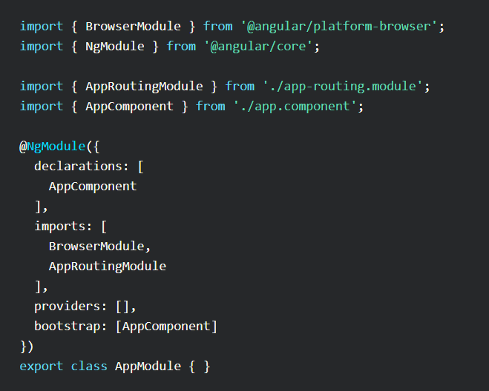

Slide 135

The HTML file is the HTML template associated with that component.
The SCSS or CSS is the associated CSS rulesets for that component (whatever is defined in the HTML file)
The .spec.ts file is for testing purposes.
The .ts file is the actual component file, and it's where you will likely spend most of your time. It defines a number of things.

Slide 136


Slide 137
Create components
ng generate component sidebar
ng g c posts
ng g c users
ng g c details

Slide 138

Templating the app
Open the src/app/app.component.html file.
Remove all existing html content and paste this.

Slide 139

Open /src/app/sidebar/sidebar.component.html file to define the sidebar templating.

Slide 140

open up /src/index.html and add the following 2 lines between the <head> tags:

Slide 141

Open up /src/styles.css

Slide 142

Open up the sidebar CSS file /src/app/sidebar/sidebar.component.scss:

Slide 143

Routing..
Open the /src/app/app-routing.module.ts file and add newly added components.

Slide 144
Services…
Create new service
ng generate service data
The purpose of our service file will be to communicate with an API via the Angular 6 HTTP Client.

Slide 145

HTTP Client…
import following code at the top of our data.service.ts file.
Before we can use the HTTPClient, we need to add as an import in our app's /src/app/app.module.ts file:

Slide 146


Slide 147

Next, let's open up the /src/app/users/users.component.ts file and import our service:
To display the results, we're going to use an Observable, so we're importing it here, too.

Slide 148


Slide 149

Next, open up /src/app/users/users.component.html:

Slide 150

Open the service file /src/app/data.service.ts and add the following methods:

Slide 151

Open /src/app/details/details.component.ts

Slide 152

Open up the details.component.html and specify:

Slide 153

let's repeat this process for the /src/app/posts/posts.component.ts file

Slide 154

And the posts.component.html file:

Slide 155

Class Binding….
Open the /src/app/sidebar/sidebar.component.ts file and add the following:

Slide 156

Class Binding….
Open the sidebar.component.html file and update it to match:

